Slide 1

2023 Joint Commission Requirements
Health Care Equity
National Association for Behavioral Healthcare
BH Services within General Healthcare Systems Committee
2022 Fall Leadership Forum
October 21, 2022
.

Slide 2
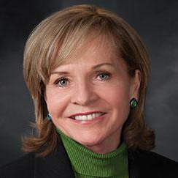
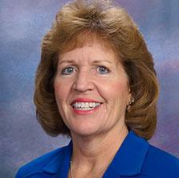
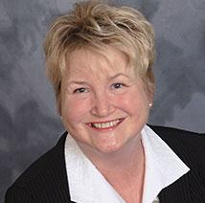


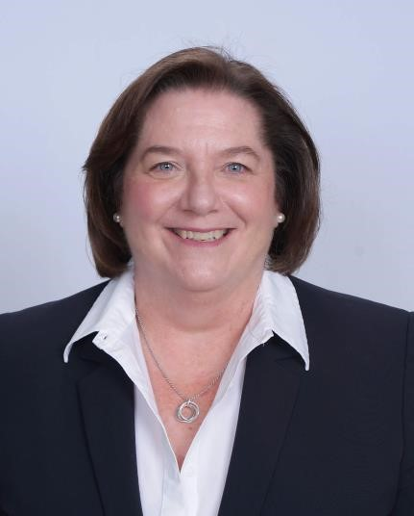






Barrins & Associates Team
Nationwide lens
on BH industry
Experts on TJC & CMS compliance
23 years in industry
Worked with 375 + BH clients
Anne Barrins
MS, CSW, CEO
Colleen Sawyer RN, MS
Claire Burchfield
LCSW, CPHQ
Mark Halal LCSW
Jared Shapiro
CHFM
Barbara Bugella
RN, MSN, MBA
Laura Sellers
RHIA
Jacqueline Gacek
RN, MS
Marianne Birmingham
MS, CHC, CTP
Jay Colamaria
RN, MS
Domenic Baratta
MPH, CSP, HEM, CHSP

Slide 3


Health Care Equity
Goal: Reduce health care disparities
Research shows disparities persist in:
  Access to care
  Quality of care
TJC identifies health care equity as a Quality and Safety priority
New requirements effective 1/1/23
3

Slide 4

Health Care Equity
New Leadership standard: LD.04.03.08
“Reducing health care disparities for the hospital’s patients is a quality and safety priority.”
Requires commitment of C-suite and Board
Should be integrated with hospital’s QAPI program
4

Slide 5

Health Care Equity
EP 1: Appoint a designated leader
  High level leader responsible for hospitalwide program to reduce health care disparities
  Organized structure for this initiative
  Establish clear lines of accountability
  Provide resources to leader and project team
5

Slide 6
Health Care Equity
EP 2: Assess health related social needs (HRSNs)
  For individual patients: assess HRSNs
    Access to transportation
    Difficulty paying for prescriptions or medical bills
    Education and literacy
    Food insecurity
    Housing insecurity
  Provide info re community resources and support services to help address those needs
6

Slide 7
Health Care Equity
Assessing HRSNs
Hospital has flexibility to determine:
  Which patients to assess for HRSNs
    Either a representative sample OR
    All patients
  Which HRSNs to assess
  Which resources to provide to address HRSNs
7

Slide 8

Health Care Equity
EP 3: Stratify your quality data to identify health care disparities in your patient population
  Stratify using socio-demographic characteristics
    Age, gender, referred language, race, ethnicity
  Goal: Understand which patient care processes, outcomes vary by socio-demographic characteristics
  Flexibility - you choose:
    Which measures to stratify
    Which socio-demographic characteristics to use for stratification of data
8

Slide 9

Health Care Equity
EP 4: Action Plan
  Choose 1 health care disparity to improve
  Requires written Action Plan – should include:
    Identify health care disparity you’ll work on
    Describe specific patient population to focus on
    State your improvement goal
    List strategies, resources you’ll use to achieve goal
    Describe process you’ll use to monitor progress
9

Slide 10

Health Care Equity
EP 5: Make Improvements
  Implement your Action Plan
  Monitor your progress using data
  Evaluate whether improvement is occurring
  Take action if you’re not meeting your goals
10

Slide 11

Health Care Equity
EP 6: Report progress to stakeholders
  Leadership, Board, Medical Staff, managers, staff
  Minimum annually
  Use committee meetings, intranet, Town Hall meetings, newsletters, etc.
11

Slide 12


Health Care Equity
Key Takeaways
  This should be a data-driven, QI project
  Include your Data Gurus
  Organize it using your PI model: e.g. PDCA
  Get started now – will be a major focus area in 2023
  First step: Review TJC guiding documents (next slide)
  Don’t be overly ambitious - better to zero in on and improve one disparity vs. tackling multiple issues
12

Slide 13
Health Care Equity
TJC Resources
Prepublication Requirements Related to Reducing Health Care Disparities: Hospital Accreditation Program
Prepublication Requirements Related to Reducing Health Care Disparities: Behavioral Health Care and Human Services Accreditation Program
R3 Report Issue 36: New Requirements to Reduce Health Care Disparities
Sentinel Event Alert Issue 64: Addressing Health Care Disparities by Improving Quality and Safety
13

Slide 14



Barrins & Associates Resources
Monthly electronic newsletter
TJC & CMS Blog - 2 posts monthly
www.barrins-assoc.com
Updates, resources, best practices
14

Slide 15

Patton Healthcare Consulting
TJC, CMS Compliance Consultation
  Mock surveys
  Continuous Accreditation Support program
  Monthly electronic newsletter
  Blog posts
  https://pattonhc.com/
15

Slide 16

Q & A

