Slide 1
Behavioral Health
High Utilizers Group (HUGs)
April 8, 2021

Slide 2

Our Team
Cheryl Dodds, MD, Medical Director
Lisa McCanna, RN, MHA, VP & Facility Executive
Keri Jansen, LCSW, Manager
Kate Penney, MA, LCMHC, Zero Suicide
Sylvia Broome, RN, MSN, CPHQ, Quality
This Photo by Unknown Author is licensed under CC BY-SA-NC

Slide 3
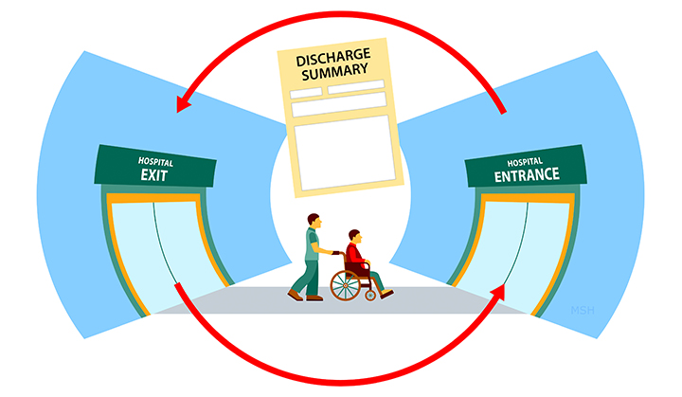
Overview of some National Statistics
CMS reports that 20 percent of Medicare patients with a mental illness are readmitted within 30 days of discharge from an acute care facility.
The National Association of Behavioral Health (NABH) reports that 9 percent of behavioral health patients are readmitted within this same time frame.
Often this is due to the complicated social factors, high non-compliance rate, and medical co-morbid conditions of many patients with mental illness.

Slide 4
Typical Interventions
ACT team referral
Extend Length of Stay for hospitalization
Court Ordered Outpatient treatment
Scheduling outpatient follow up
Outpatient groups and medication management
Psychoeducation about illness and treatment

Slide 5
ACT team and Court ordered outpatient
Lengthy process to get patient accepted
Funding source
Patient still has to agree and cooperate
Patient must have appropriate diagnosis
Court order must be enforced
Court orders are less effective with patients who have substance abuse

Slide 6
Longer Length of Stay
Cannot be readmitted while you are still in the hospital
Fosters dependence
Can cause patient to lose job, housing

Slide 7
Case management/ Outpatient services
Patient must engage
Transportation issues
Less monitoring of compliance
Vulnerable to substance abuse relapse
No show rate is very high

Slide 8
Residential Substance Treatment
Availability
Patient must engage
Options very limited if patient requires Suboxone or Methadone
If discharged from program, patient likely to be readmitted.

Slide 9
Where are we failing our patients?
Thoughts?

Slide 10

Aim Statement
Our initial aim was to reduce all cause, all facility readmissions of the highest utilizers of behavioral healthcare.
We took our model from an existing case review structure in the BH Service Line called the PARC (Patient at Risk Committee)
As the project progressed, we identified the following goals:

Slide 11
Goals
Establish a HUG list
Organize a multi-disciplinary team to review cases
Provide standardized note with care plan
Meet at regular, predictable intervals virtually
Educate providers on accessing plans.
Include peer support to prevent process from becoming punitive.

Slide 12
Gathering information
Readmission interviews
Calls within 72 hours of discharge
Discharge group

Slide 13
Background
In 2016, we identified a cohort of psychiatric patients who frequently visited ED’s and were readmitted
Initially, we focused on our top 10 most frequently admitted patients, some were seen in our ED’s up to 352 times/year and admitted up to 11 times/year.
We coordinated a multidisciplinary team and developed care plans that span inpatient, outpatient, and ED settings.

Slide 14

Do Phase (Interventions)
Forum to review patients at high risk for readmission established and named HUGs
Initial patients were BHD/BHC “Top 10.”
Referrals of cases come from providers across the BH Service Line, Community Care Partners, LME’s (Cardinal & Partners) and Novant and other specialties including Emergency Medicine, Internal Medicine and Pediatrics
The HUG’s take weekly at a consistent time virtually to encourage attendance
Provider familiar with patient presents the case. IP providers, social work, pharmacy, other specialties and peer support discuss case
The plan is entered into the medical record under an ED Care Plan flag. This makes the plan accessible to ED and Inpatient settings.

Slide 15

Do Phase (Interventions)
Virtual Addiction consults provided to patients with substance use disorders (SUD).
The Addiction Specialist attends “HUG” to offer input into care plan
Chart is reviewed prior to meeting and during HUG meeting.
Medication history reviewed by BH PharmD and recommendations made for management.
ED Care Plan entered and reviewed during the meeting.
Names and numbers of caseworkers for patient provided in plan.
HUG educational emails are sent BH providers about making referrals and using care plans
Regular follow up done with providers who do not acknowledge or follow plans to see how plans can be altered to be more helpful.

Slide 16
Do Phase (Interventions)
Involved Novant BH Medical Director in review of mutual cases
LME representatives included in meetings and encouraged to make referrals. Give perspective on patient engagement after discharge.
Include Utilization Review in HUG meetings for input on resources available through payor sources
Include Occupational Therapy in meetings to implement accommodations to help patient with compliance and behavioral control
Integrate Zero Suicide referral into care plans.
Include Peer support on multi-disciplinary team to serve as patient advocate during plans.

Slide 17
HUG Audience
ED provider
Telepsychiatrist/ BH ED psychiatrist
Community Care Bridge
BH Patient Placement
Medical/ Pediatric IP provider
Consult Liaison Psychiatrist
Consult Liaison Addictions Specialist
IP Psychiatrist
IP Social Worker
OP Psychiatrist/ therapist
PCP

Slide 18
Sample BH HUG Note
History: 30 yo male with history of Schizophrenia and Cocaine Use Disorder as well as HTN, HIV positive, is referred to the HUG secondary to 3 inpatient BH admissions and 98 ED visits in the past 12 months. Patient has a history of aggression and incarceration and typically refuses referral to outpatient resources.
Typical presentation: Intoxicated, reporting SI with plan to walk into traffic.
PMH: HIV, HTN
Medications: Has failed Latuda and Zyprexa. Responds well to Risperdal
Social: Currently homeless, no active support system

Slide 19
HUG note continued
Recommendations:
1. Please no controlled substances.
2. Minimize comfort measures such as extra blankets or snacks
3. Notify Community Care Bridge case manager Jane Doe LCSW at 704-111-1111, when patient presents in ED
4. Recommend admission to BH IP unit to stabilize patient on meds
5. Consider trial of Invega Sustenna LAI to improve compliance
6. Recommend referral to ACT team services
7. Advocate for a payee to be assigned a payee.
8. Request court order for outpatient treatment

Slide 20
Questions and Discussion?

Slide 21
What could go wrong?
HUG used to punish patient
Take away reinforcers for readmission, but fail to provide benefit of staying in the community
Increase ED visits
Providers ignore HUG recommendations
Providers fail to attend HUG and give input
Patient does not respond to interventions.
HIPAA limitations on including community partners
Patient talks Lyft driver into taking them somewhere other than recovery program
Patients still do not keep outpatient appointments
Patients relapse on drugs and alcohol and get readmitted
Patients continue to present to the ED reporting suicidal ideation

Slide 22
Act Phase
Engage our BH ED psychiatrists to access our care plans
Continue to collaborate with community partners to participate in the HUGs and get releases when needed and able
Conduct weekly HUGs at standard time. Meeting is virtual.
Reach out to patients by phone within 72 hours of discharge
"ReHUG" patients who continue to be frequently readmitted
Review cases of patients who no longer are admitted, but continue to be seen in the ED frequently.
Involve Zero Suicide and VPN and VTC to help support patients outside of the hospital
Look at "buckets" of causation for readmission for global resources that need to be accessed (i.e. food, medication, safe housing)

Slide 23
Questions and Discussion?
Who do you think we see?
What are the largest barriers to preventing readmission?
What do you think the “buckets” are?

Slide 24
Case Intervention Examples
Chronic pain patient using inpatient (IP) BH stay to supplement opioid supply
Chronically psychotic, cocaine abusing patient who is frequently discharged quickly because of disruptive behavior
Cocaine abusing patient with disability who uses income for drugs and seeks refuge in BH hospital to escape debt to drug dealers
Patient with Hypochondriasis who seeks ED care daily and has frequent BH IP stays
Pregnant patient who is sex trafficked using hospitalization to escape domestic violence
Patient with Factitious Disorder who seeks hospitalization for medical procedures.
Child patient who seeks observation stay at LCH to avoid toxic home environment
Patient with chronic psychosis who repeatedly presents requesting SANE exams.

Slide 25
Potential Interventions
Contact outpatient provider to connect regarding patient's use of pain medications
Conversion to Buprenorphine
Recommend involuntary admission, long acting injectables (LAI) medications and long Length of Stay (LOS) IP at next presentation
Recommend application for payee and/or guardian for patient
Community Para Medicine referral
Referral to same unit and team next admission
Referral to supportive residential setting for victims of sex trafficking, such as Lilly Pad
Connect with Cardinal case worker, Care Bridge or ACT team

Slide 26
Added Interventions
Virtual Patient Navigator—to follow patients by phone after discharge from ED, to prevent admission
Zero Suicide—follows patients at high risk of suicide for up to 45 days after discharge to insure safe transition into outpatient care.
Discharge groups to educate on follow up, connect virtually to provider and teach support services available in community
“How to be homeless” group materials developed for appropriate patients.
Strengthened connection/ communication with shelters.
Developed virtual outpatient, IOP and PHP services
Virtual Transition Clinic

Slide 27
Does it work?

Slide 28
Data Limitations
Limitations:
1. Analysis is observational and cannot determine causality.
2. Analysis is unadjusted, not accounting for confounders that might impact the probability/likelihood of experiencing a readmission.
3. Not accounting for seasonality and temporal trends [trends that occur prior to intervention]
4. Only capturing a certain % of the entire HUGS population. Roughly a total of 150 patients, able to find unique patient identifier on 87 patients. Step 1 captures only half (53%) of the identified patients and only 31% of the entire HUGS population. Step 2 captures 80% of the identified patients, but only 47% of the entire HUGS population. Step 3 captures 61% of the identified patients, but only 35% of the entire HUGS population.

Slide 29
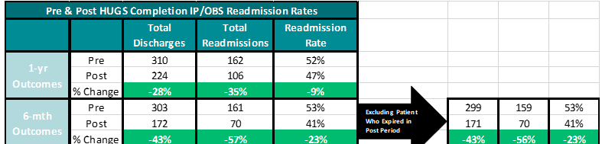
Outcome Data
23 precent decrease in readmission at 6 months
9 percent decrease in readmissions at a year.

Slide 30
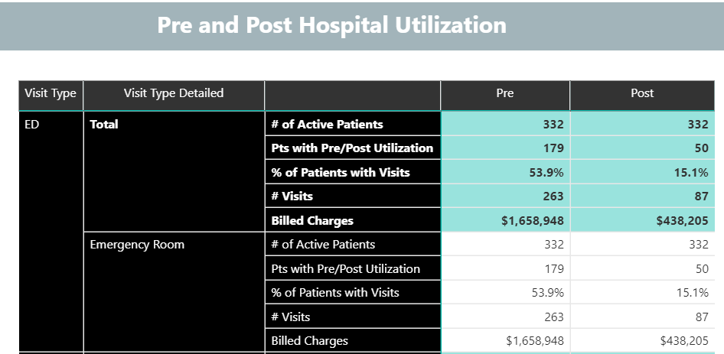
Zero Suicide Data

Slide 31
Zero Suicide Results
Since 4/2019 and the implementation of the Zero Suicide Pathway for patients, we have seen a savings of over 1.2 million dollars in ER visits for those enrolled in the Pathway upon discharge. Patient visits to the ED have dropped off 67% in the pre and post utilization numbers of 332 patients who have been enrolled on the Pathway.

Slide 32
Virtual Patient Navigation
Program Goals
Program Elements
Decrease Admissions
Increase Discharges
Follow-Up Compliance
Reduce Unnecessary ED Visits
Reduce Readmissions
Introduction to the patient follow-up process prior to ED discharge
Follow-up evaluation within 72 hours by phone
Weekly contact includes:
  C-SSRS Reassessment
  Identifying & assisting with barriers to appointments/medications
  Providing appropriate referrals
  Supportive listening

Slide 33
VPN Results
Patients were
26% less likely to be admitted
on days when the Virtual Patient Navigator was available
Odds Ratio 0.74 (0.54-1.02)
And had a significant decrease in return visits for self-harm within 30 days

Slide 34
VPN by the numbers: 2020
 | Virtual navigation only | In person navigation only | Combined
Active patients | 1,325 | 630 | 1,955
Reduction in ED visits | 63.8% | 58.7% | 62.1%
Completed interactions | 18,194 | 783 | 18,977
Fewer billed charges | $5,365,401 | $2,008,236 | $7,373,638

Slide 35
How did Covid impact readmissions
BH Surge
Decreased Observation Stay
Higher volume of inpatients, some with very short length of stay
Staff shortages secondary to pandemic
Less staff attention per patient
Less communication with outpatient providers
Less family engagement
Fewer shelter and rehab options
Higher overall substance abuse and suicide rates
Higher readmission rates.

Slide 36

Lessons Learned
In the investigation of each patient’s case, we found three common themes contributing to the readmission cycle:
  Addiction issues
  Social issues
  Follow up outpatient care location
Addiction
Social
Care Location

Slide 37
Main barriers to decreasing readmission
Failure to prevent drug/ alcohol relapse
Lack of residential substance abuse treatment programs
Residential programs not allowing Suboxone treatment
Failure to keep outpatient appointment and continue medication
Homelessness and food insecurity
ED and IP medical providers continuing to prescribe benzodiazepines and opioids

Slide 38
Lessons Learned - Spreadability
Collaboration and communication helped the team find new ways to partner and learn about additional resources for patients in the community
Increased information on what happens after discharge from LME partners and Zero Suicide
A decrease in readmissions for HUG patients supports continuing and refining the model

Slide 39
Areas for Improvement
Engagement across BH Service Line and expansion into other specialties
Inclusion of agencies outside of Atrium Health
Systematic review of cases and update of plans
Expansion to other health care systems
Ability to directly deploy resources from the HUG meeting
  Behavioral Plans/ OT interventions
  Direct communication with primary provider
  Communication between ED provider and IP provider
  Zero Suicide referral/ BH follow up calls
Expansion to specialized populations such as child and pregnant patients

Slide 40

Next Steps
Continue the work and collaboration
Continue to monitor the process and adjust as appropriate
Expand access to Addiction services (opened BHC Addiction services, partnering with CHA to provide addiction services to pregnant women).
Expanding into CHUG—child HUG.
Perinatal case reviews between different disciplines
Develop behavioral plans and safety plans easily accessed and utilized through the EMR

Slide 41
Patient A
Patient's case was reviewed by the High Utilizer Group on:10/6/20
Brief clinical synopsis: 30 yo male referred to the HUG secondary to frequent ED visits. Patient has a history of adjustment disorder, malingering, AIDS (recently diagnosed), Methamphetamine Use Disorder, Cannabis Use Disorder. He is currently homeless and reports history of sexual abuse by father as an adolescent. He has had 92 ED visits with Atrium in the last 12 months. He also is frequently seen in the Caramont and Novant ED's. He reports a past history of a suicide attempt by hanging, but has reported conflicting timing of that attempt at different ED visits. He is resistant to being linked to support services. He tends to be irritable in the ED. He can be combative at discharge.
Common presentation: Reporting SI, wanting a place to stay, wanting something to eat.
Past medical history: AIDS
Social support: Homeless.
All treatment options from a high utilizing meeting should be considered in the context of patient's clinical presentation. Other options may be more reasonable depending on the patient's presentation.
Treatment options to consider:
1. Please avoid controlled substances if at all possible.
2. Consider referral to Cadre.
3. Be aware he can be combative at discharge and have security on stand by,.
4. Have Medic consistently take him to BHC ED, regardless of his request, if not acutely medically ill.
5. Please minimize comfort care including sandwiches and blankets.
6. Referral to psychosocial rehab at InnerVision, or other PSR options.
7. Please contact Laura Covian at Community Care Bridge when patient presents in the ED 704-223-5003.

Slide 42
Patient B
Patient's case was reviewed by the High Utilizer Group on: 8/19/20
Brief clinical synopsis: 49 yo female with significant history of polysubstance use disorder. Recently alcohol has been her drug of choice. Drinks significantly everyday. She has Bipolar Disorder and PTSD. She accidentally ran over her 3 yo son and he died. Her husband died of cancer. Her grown daughters refuse to have contact with her. She lives with a roommate who wanted romantic relationship she does not like. He works all day and she is alone day. She enjoys inpatient environment and socialization. Does not like having room restriction for medical concerns here. She has done well at Hope Haven in the past, but not in other substance abuse programs. she has poor self esteem. Has had OT interventions inpatient to work on self care. She lives in Union County and has no transportation. She has expressed concerns of not being safe in her home with roommate.
Common presentation: Presents with suicidal ideation without plan, with elevated BAL
Past medical trials: Every antidepressant except Trintellix and Zoloft, Has tried Lithium and Depakote, Buspar and Naltrexone.
Past medical history: Obesity, HTN.
Social support: Roommate
Treatment options to consider:
1. All treatment options from a high utilizing meeting should be considered in the context of patient's clinical presentation. Other options may be more reasonable depending on the patient's presentation.
2. Please no controlled substances either benzo's or opiates in ED or IP outside of detox protocol.
3. Referral to McCleod or Anuvia for 28 day program with plan to transition to Hope Haven.
4. Explore if there is domestic violence in the house.
5. Community Care bridge can assist with transportation to appointments.
6. Attempt to keep LOS as short as possible and discharge directly to Anuvia or McCleod.
7. If she states she just wants to go home and see her Mom--this is a suicidal remark as her mother is deceased.

Slide 43
Questions

