Slide 1
Transcranial Magnetic Stimulation
Where are we now and where are we going?
Nicole Aho, MD
Interventional and Neurocognitive Psychiatry
October 2022

Slide 2
Disclosures
I have no conflicts of interest to disclose

Slide 3
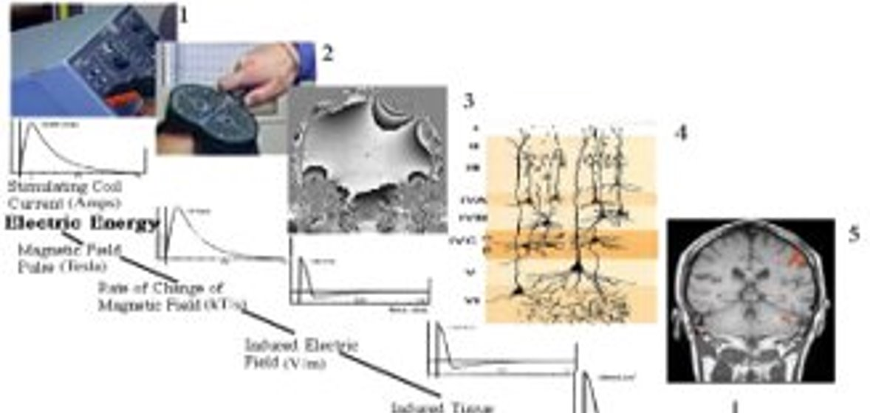
What is TMS
Reference 5
Notes:
1790’s: Luigi Galvani and Alessandro Volta conduct a number of bioelectricity experiments and discover that nerves carry electrical energy within the nervous system.
1831: Michael Faraday discovers the principles of electromagnetic induction, in which a current is produced by a change in magnetic flux.
1875: David Ferrier experiments with low intensity electrical stimulation to the brain, revealing that the cortex contains a precise map of motor function.
Early 1900’s: Scientists study magnetic stimulation in depth. Many attempts at using electromagnetic induction prove unsuccessful because of the limited technology available for creating magnetic fields suitable for treatment.
1959: Alexander Kolin and his colleagues find that magnetic fields can be used for nerve stimulation and muscle contraction in a frog.
1965: Scientists Bickford and Fremming demonstrate that magnetic fields can be used to stimulate muscles among humans.
1985: Anthony Barker and his colleagues Reza Jalinous and Ian Freeston study the use of magnetic fields to alter the brain’s electrical signals, and introduce the first TMS device.
1985: Barker, Jalinous, and Freeston perform the first successful transcranial magnetic stimulation as a noninvasive treatment capable of stimulating precise regions of the brain without electrical stimulation or pain. This paved the way for the therapy’s later use in a range of therapeutic and diagnostic procedures, including depression treatment.
1987: Barker and his colleagues release a set of TMS safety guidelines.
1990’s: Numerous studies indicate that TMS is safe and effective in the treatment of major depression.
2003: Health Canada approves the use of TMS therapy as a depression treatment in Canada.
2008: FDA approves the use of TMS as therapy for the treatment of major depression.
2010: A clinical trial by the The National Institutes of Health (NIH) indicates TMS therapy is an effective form of treatment for depression.
2013: A number of U.S. health insurance companies widely began to cover TMS as a treatment for depression.
2017: TMS therapy is widely used as a safe and effective treatment of major depression, especially in cases where drugs prove ineffective.

Slide 4
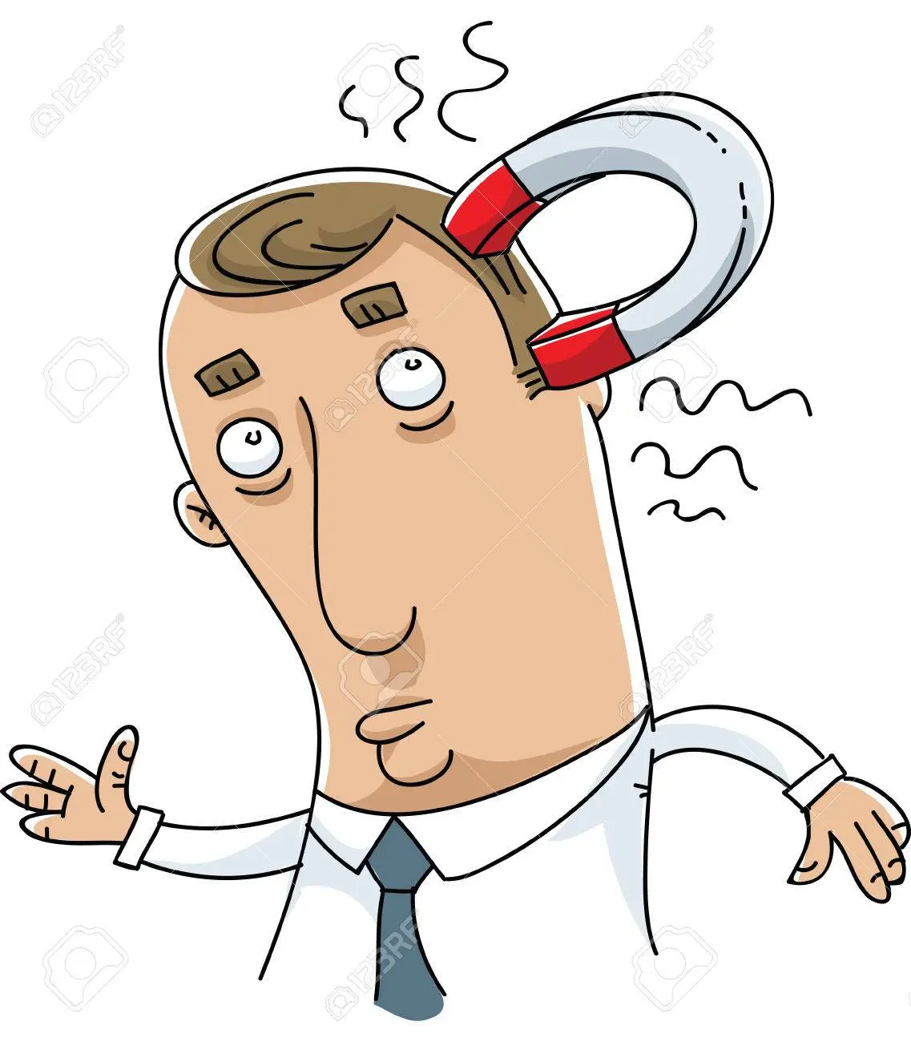
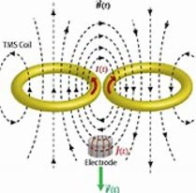
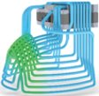
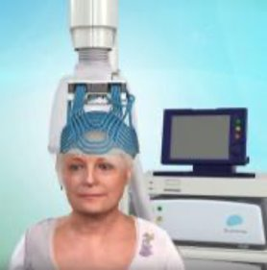
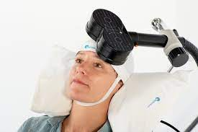
What is Transcranial Magnetic Stimulation (TMS) ?
NOT TMS
TMS
rTMS
dTMS
Figure 8​ coil
Neuronetics​
Magstim​
Magventure​
Nextstim​
Cloud TMS​
Mag and More​
​
Hesed (H) Coil
BrainsWay
Reference 1, 2, 3, and 4

Slide 5
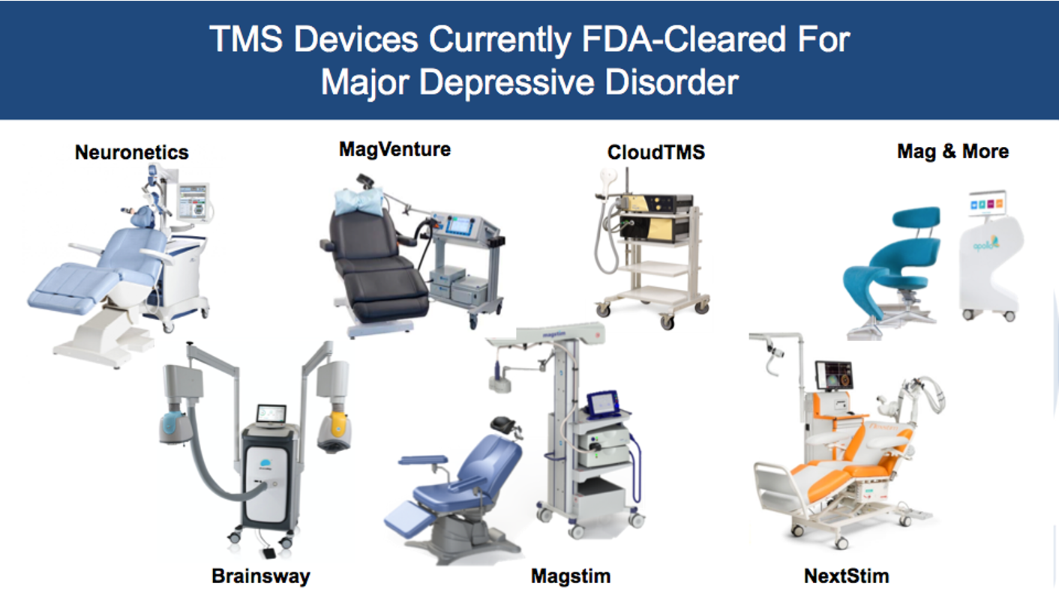
TMS Devices
Reference 6

Slide 6
Evolution of TMS
1831 - Michael Faraday - principle of electromagnetic induction
electricity and magnetic energy are interchangeable
1896- D’Arsonval - first TMS devices
1910 - Sylvanius P. Thompson - 3 papers on TMS and phosphenes
1959 - Kolin - demonstrated magnetic fields stimulate frog muscle
1985 – Barker - modern TMS developed
1993 - First therapeutic cases reported in depression
2008 – First FDA cleared device, Neurostar, hits the market to treat non-psychotic unipolar depression
2013 – Brainsway device is FDA cleared
2013 – Device approved for abortive treatment of migraine with aura
2015 – Magstim and Magventure devices cleared
2017 - Approved for the acute and preventative treatment of migraines in individuals 12y.o and older
2018 – Brainsway coil gets FDA OCD approval and theta burst protocols get FDA approval for depression
2018 – Mag and more device cleared
2020 – Approved as an aid in short-term smoking cessation
2020 – Magventure figure 8 butterfly coil approved for OCD
2021 – TMS Approved for MDD with anxious distress
2022– SNT protocol approved

Slide 7
TMS FDA Indications
2008 – Treatment resistant non-psychotic unipolar depression
2013 – Device approved for abortive treatment of migraine with aura
2017 - Approved for the acute and preventative treatment of migraines in individuals 12y.o and older
2018 – dTMS for OCD
2018 - Theta Burst Protocols for treatment resistant non-psychotic unipolar depression
2020 – Approved as an aid in short-term smoking cessation
2020 – Magventure figure 8 butterfly coil approved for OCD
2021 – MDD with anxious distress
2022– SAINT/SNT protocol/device approved/cleared – 1st FDA approved depression treatment that includes structural and functional MRI

Slide 8
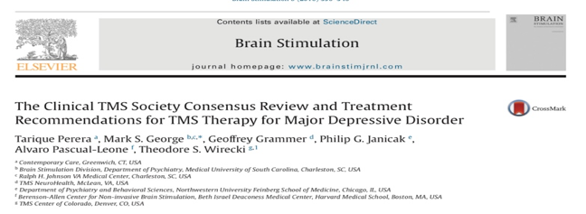
TMS for Unipolar Depression
MDD, severe, without psychotic features (single or recurrent episode)
Several RCTs and multiple meta-analyses
Evidence supports superiority over sham
Overall Response Rate (50% reduction in symptoms): 41-56%
Overall Remission Rates (Most all symptoms resolved): 26-28%
Reference 7

Slide 9
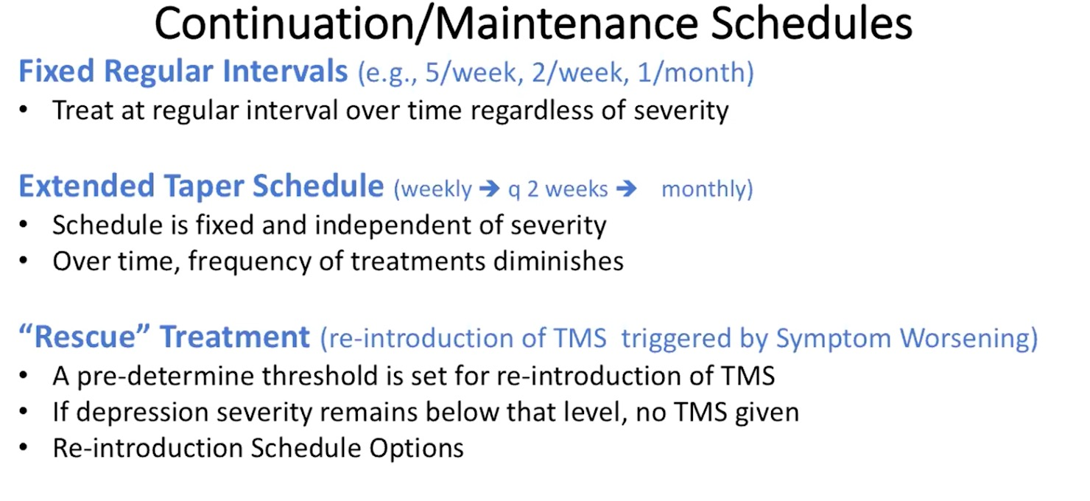
Future – Maintenance TMS for Depression
Reference 13

Slide 10
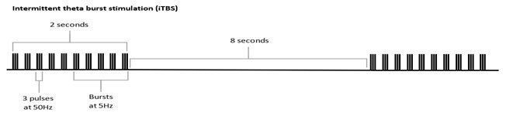
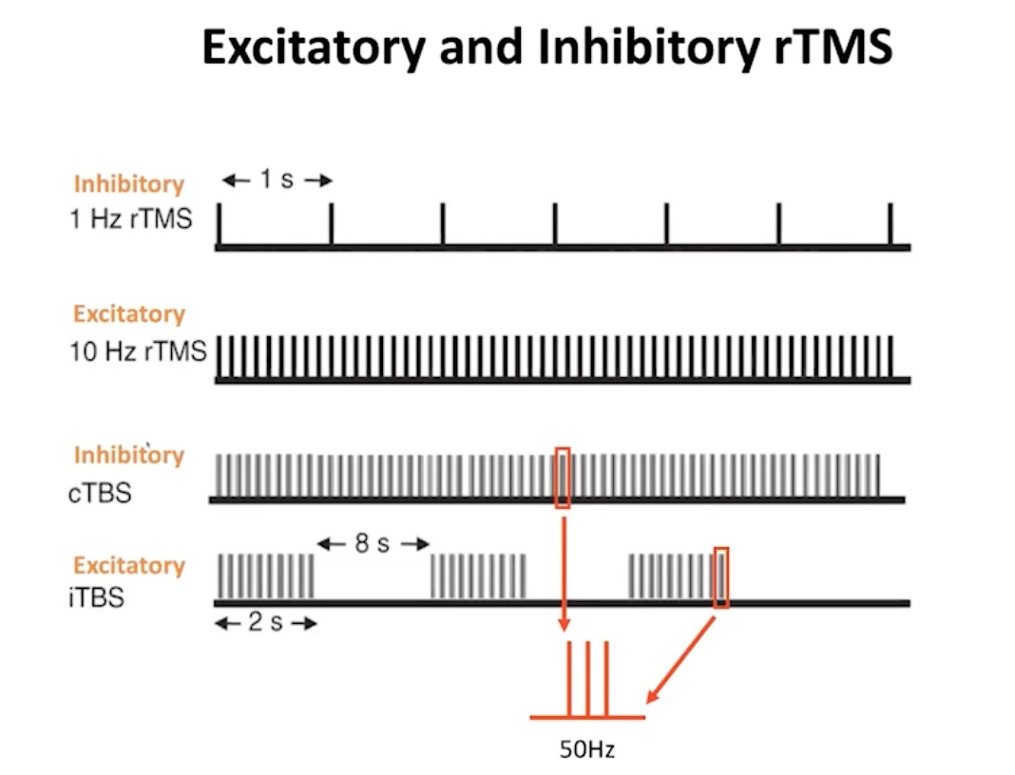
Theta Burst TMS (TBS)
Quick facts:​
1. Mimics hippocampal neuronal firing​
2. Done in 3min 9sec​
3. FDA cleared in 2018 based on a non-inferiority study ​
4. Can hurt a lot but it's quick​
Reference 8, 14

Slide 11
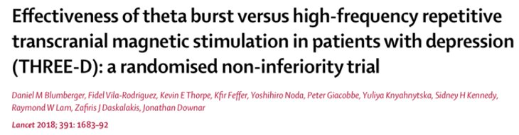
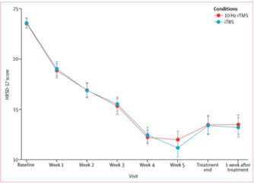
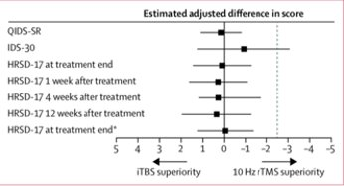
TBS

Slide 12
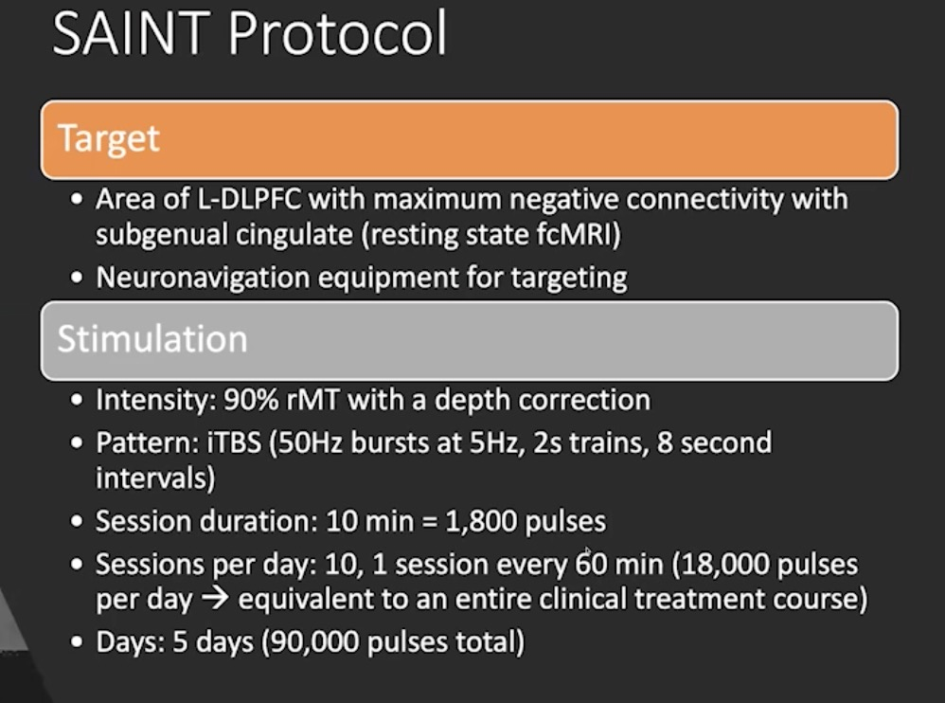
Future – SAINT Protocol
SAINT Protocol - Stanford Accelerated Intelligent Neuromodulation Therapy
Reference 14

Slide 13
Future – SAINT Protocol
SAINT Protocol - Stanford Accelerated Intelligent Neuromodulation Therapy
  3 SAINT clinical trials
1. N = 6; open label; the MOST severely depressed and treatment resistant; 5 of 6 reached remission.
2. N = 22; open label; TRD; 19 of 22 participants (86.4%) met remission criteria in ITT analysis
Reference 9

Slide 14
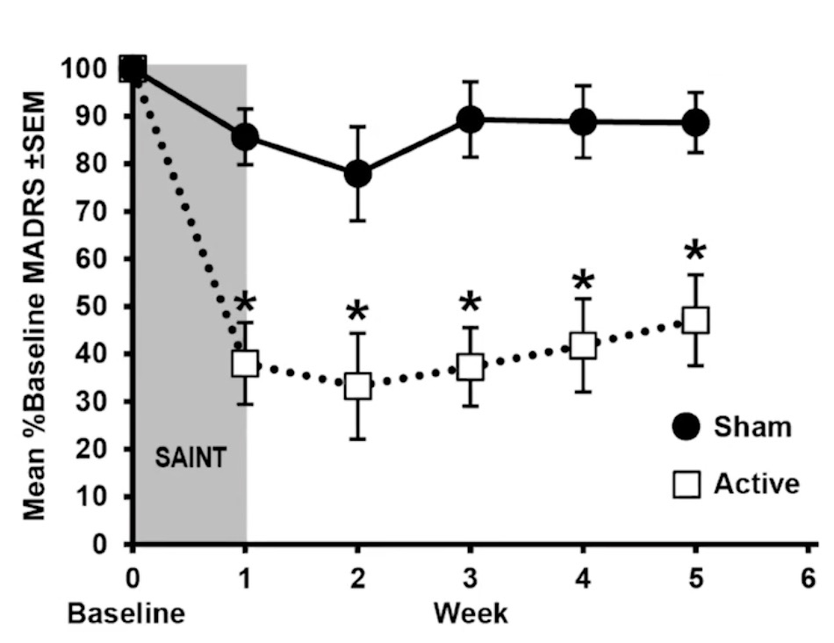

Future – SAINT Protocol using TBS
3. RCT, double blind
22-80 y.o TRD
N = 32 randomized
Resting-state fcMRI used to individually target the region of the left dorsolateral prefrontal cortex most functionally anticorrelated with the subgenual anterior cingulate cortex.
Interim analysis - mean percent reduction from baseline in MADRS score 4 weeks after treatment was 52.5% in the active treatment group and 11.1% in the sham treatment group
Trial stopped after midpoint analysis due to significantly large differential in effect size between the groups
Reference 9, 12

Slide 15
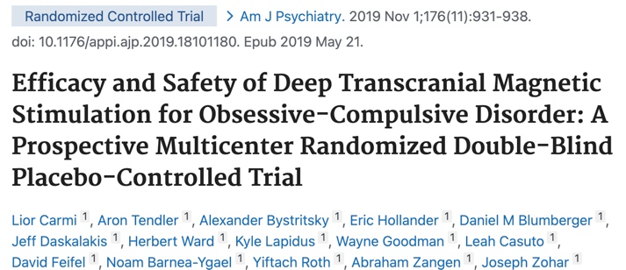
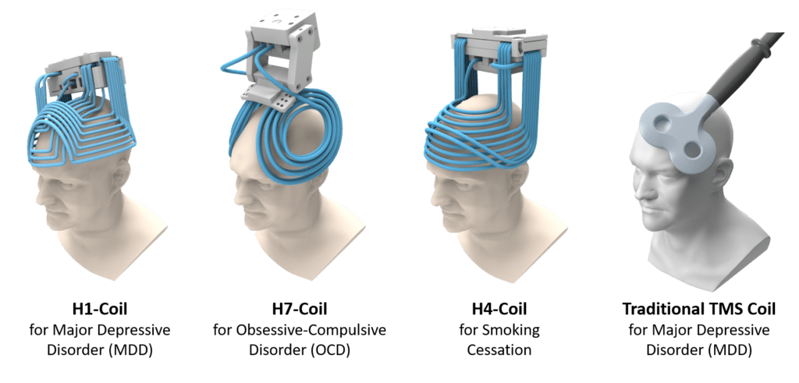
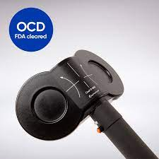
TMS for OCD
Multicenter RCT
11 sites in North America & Europe​
All outpatients​
Remained on meds but stable doses for 2 months (adjunctive therapy)​
Starting YBOCS >20​
N = 99​
Primary objective – compare the YBOCs baseline to week 6 and CGI​
Used a 5 min provocation​
Targeted bilateral medial prefrontal cortex and ACC​
HF dTMS​
Reference 15, 16

Slide 16
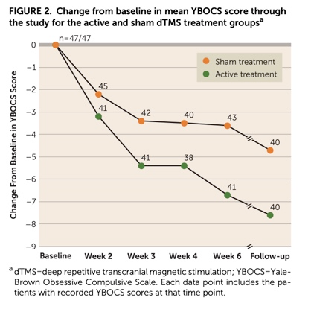
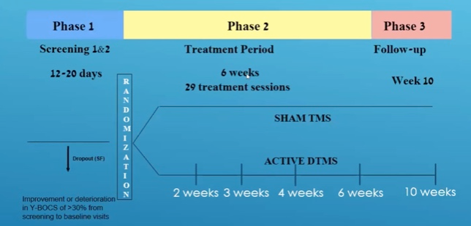
TMS for OCD
YBOCS score – dTMS reduction 6 points compared to sham reduction 3.3 points.
Reference 17

Slide 17
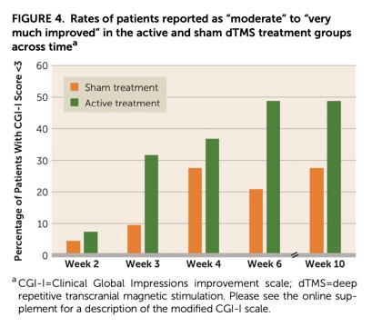
TMS for OCD
38% of patients responded (>30% reduction in YBOCS) to TMS versus 11% of patients undergoing sham
Remission is rare in OCD; as is the case with SSRI treatment
At 1-month follow- up, the response rates remained statistically significant - 45.2% in dTMS group and 17.8% in the sham treatment group.
Large, long-term durability studies are not yet available
Likely best used as an adjunct to exposure therapy and medications
Reference 17

Slide 18
Future - TMS for PTSD
First RCT study in 2004 by Cohen et al
Multiple RCTs (~9 to date), several case studies and open label studies proving benefits with large effect sizes
TMS in this population widely demonstrated to be safe and tolerable with significant and clinically meaningful reductions in core PTSD symptoms
Problem
  small N's
  variable treatment parameters and locations make synthesizing results difficult
Reference 10

Slide 19
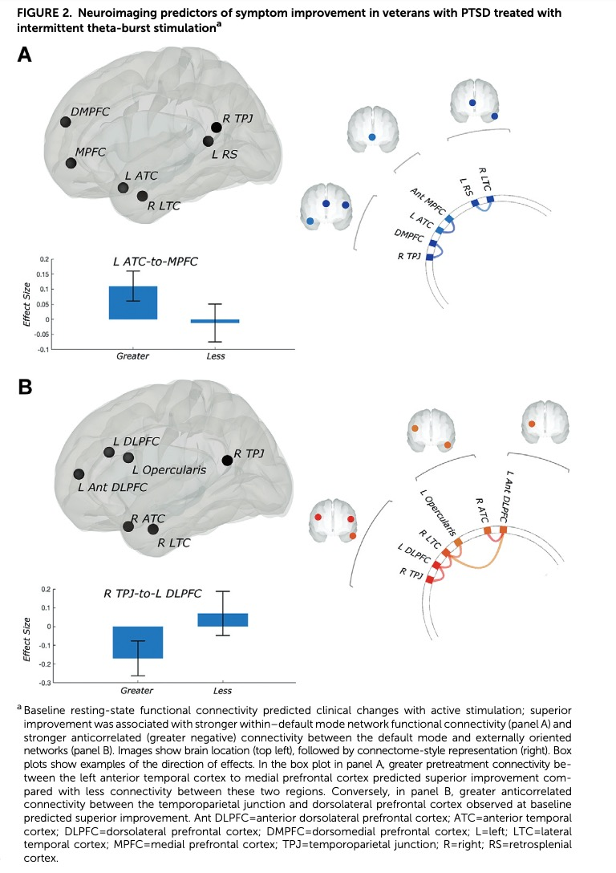
Future - TMS for PTSD
Dr. Noah Phillips and team Providence VA and Brown University looking at TBS for PTSD with positive results – 2 week outcomes indicated positive outcomes of iTBS on social and occupational functioning
Neuroimaging biomarkers
Reference 11

Slide 20
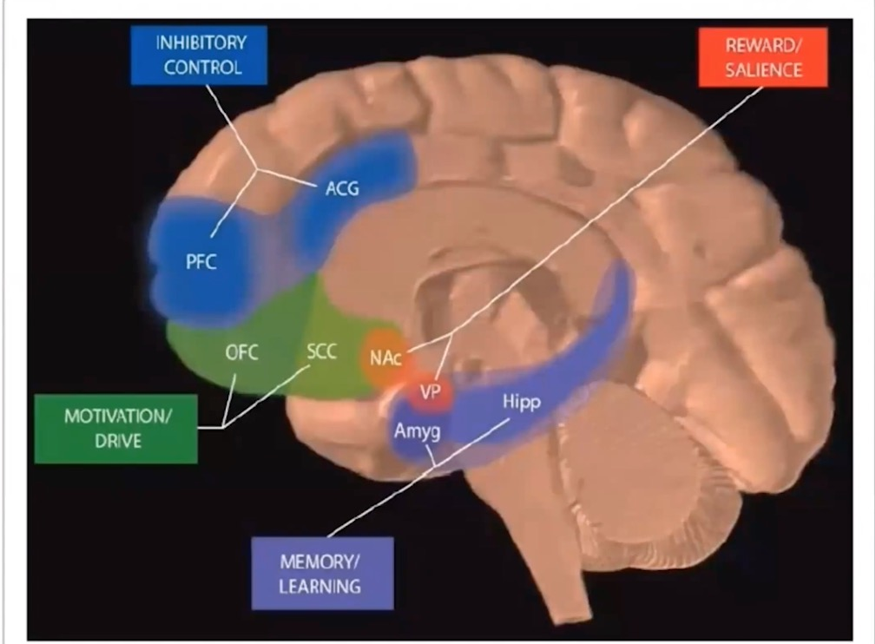
TMS to aid in Smoking Cessation
SUD Treatment Network Targets
1. Increase Control (enhance executive circuits )
2. Decrease Cravings (decrease limbic arousal circuits )
​
​
​
​
Reference 18

Slide 21
TMS to aid in Smoking Cessation
History
2009 – Addiction Journal – Amiaz et al – 2 weeks rTMS. TMS plus cue showed the biggest response.
2011 – Biol Psych – Jed Rose et al – Single session HF rTMS to vmPFC with cue elicited craving was beneficial
2013 – Biol psych – Xingbao Li et al– Single HF rTMS to DLPFC with cue elicited craving was beneficial
2014 – Bio psych – Dinur-Klein et al– RCT of dTMS to PFC and insula bilaterally, N=115, HF with a cue biggest effect, checked urine markers as well, 40% of subjects quit at 3 weeks, 6 months later sustained.
2017 – JAMA psych – Brett Froeliger et al – Increase inhibitory control with TMS led to decreased time to smoking relapse
2020 – Frontiers in psych – Roger Newman-Norlund and Brett Froeliger – single session theta burst to the inferior frontal gyrus; cross over design; high frequency and low frequency TBS given to each subject (single session of each); high frequency iTBS improved inhibitory control, cTBS did not.
2020 – Brain stim – Xingbao Li – RCT 2 weeks, N=42, 10Hz, DLPFC, cue induced, TMS group had decreased use compared to sham. Everyone was asked to quit, only some in the active group were able to quit, none in sham.

Slide 22
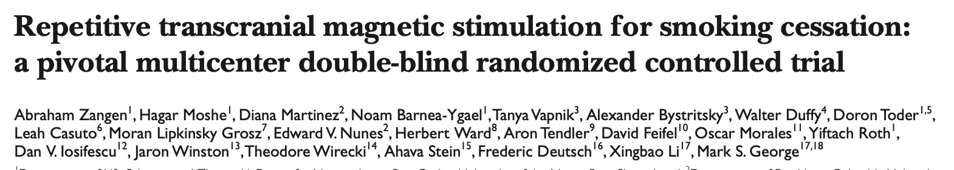

TMS to aid in Smoking Cessation
Fact: Insula damage in stroke patients led to them quitting.
Question: How can we get deep enough to hit insula?
Answer: dTMS H4 coil
FDA approval study​​
12 site trial - US and Israel​
~6 yr study ​
N = 262 ​
Target – BL PFC and insula​
Heavy smokers (68% failed to quit at least 3x)​
Included provocation cues, self-reports and urine samples​
2 minute motivational talk post-treatment
dTMS ​H4 coil
10HZ 120% MT, 18 sessions ​
Reference 19 and 20

Slide 23
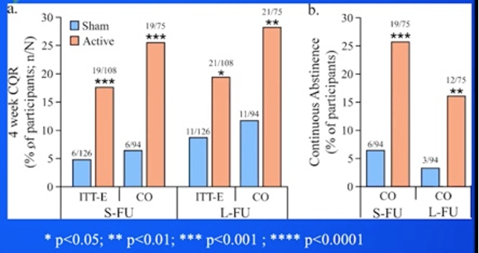
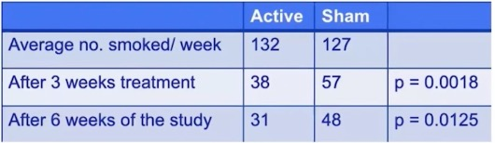
TMS to aid in Smoking Cessation
Primary end point was 4-week Continuous Quit Rate (CQR)
CQR was 28% in treatment group versus 11.7% in sham group (p=00.0063)
A secondary end point was reduction in number of cigarettes smoked.
Reference 19 and 20

Slide 24
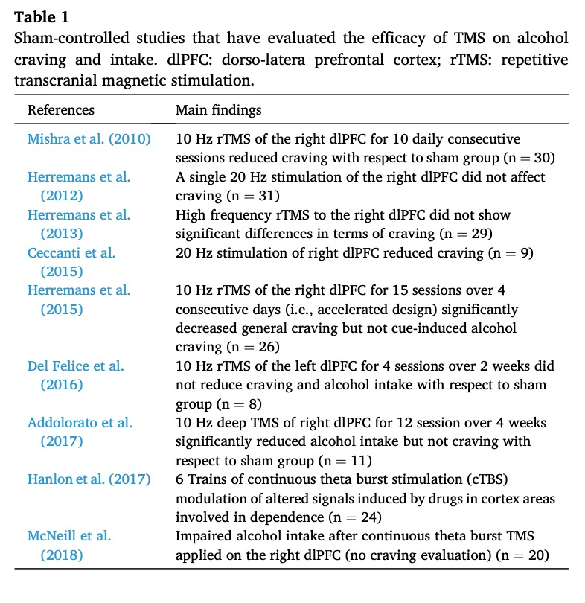
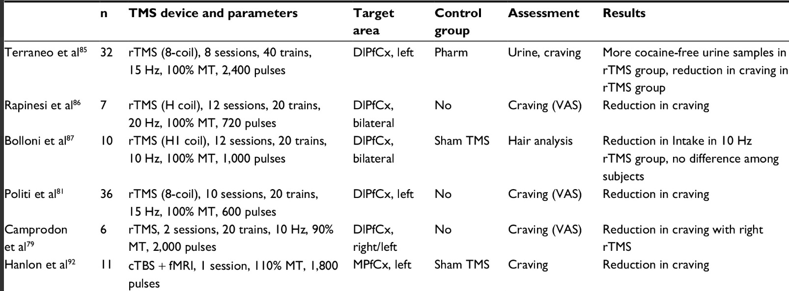
Future - TMS for Substance use disorders
Alcohol
Cocaine
Reductions in craving easier to obtain in cocaine use disorder
Reference 21, 22,

Slide 25
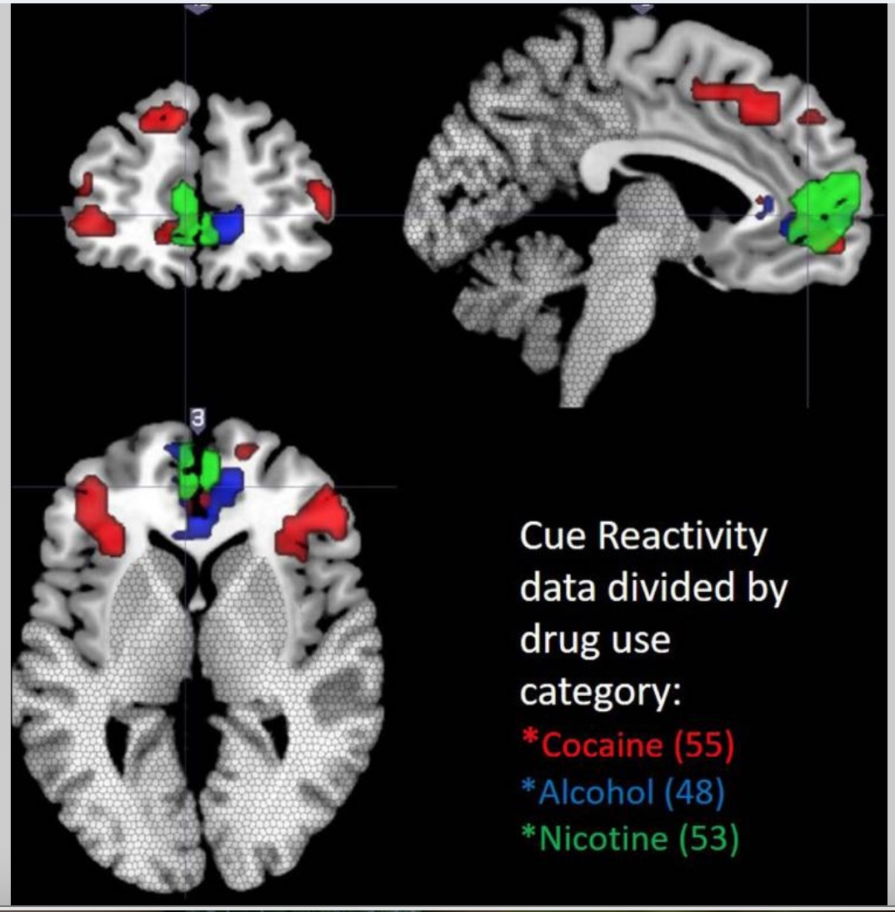
TMS in SUD – Target Identification
Is there a common location of cue-reactivity in substance use disorders?
Reference 23

Slide 26
Future - TMS for _______
Chronic pain
Post-stroke rehab
TBI-associated depression
Schizophrenia
ADHD
Antenatal/Prenatal/Post-partum depression
Autism spectrum disorder
Neurosurgery
Brain mapping
Fibromyalgia
Post-operative pain control
Eating disorders
Spasticity
Cognitive Neuroscience
UNDERSTANDING BRAIN DISEASE

Slide 27
References
1. https://www.123rf.com/photo_29635408_a-cartoon-magnet-attached-to-a-mans-head.html
2. https://brainandspinalinjury.org/wp-content/uploads/2019/12/Talk-2-Tarapore-Clinical-applications-of-TMS.pdf
3.https://www.magventure.com/us/component/k2/in/repetitive-transcranial-magnetic-stimulation-rtms-using-different-tms-instruments-for-major-depressive-disorder-at-a-suburban-tertiary-clinic
4. https://www.neurocaregroup.com/brainsway_dtms
5. Image used with permission from Mark George slide deck
6. CTMSS website. https://www.clinicaltmssociety.org/tms/devices
7. Carpenter, L. et al., Transcranial Magnetic Stimulation for Major Depression: A Multisite, Naturalistic Observational Study of Acute Treatment Outcomes in Clinical Practice. Depression and Anxiety. 29:587–596 (2012).
8. https://www.magstim.com/row-en/2019/03/fda-clearance-theta-burst/
9. Cole et al, Stanford Accelerated Intelligent Neuromodulation Therapy for Treatment-Resistant Depression. American Journal of Psychiatry. 177:8, August 2020.
10. Petrosino et al. Ther Adv Psychopharmacol. Transcranial magnetic stimulation for post-traumatic stress disorder. 2021 Oct 28
11. Philips et al. Am J Psychiatry. Theta-Burst Transcranial Magnetic Stimulation for Posttraumatic Stress Disorder. 2019 Nov 1;176(11):939-948.
12. Cole et al. Am J Psychiatry Stanford Neuromodulation Therapy (SNT): A Double-Blind Randomized Controlled Trial. 2022 Feb;179(2):132-141.
13. CTMSS Grand Rounds. Dr. Linda Carpenter. Maintenance TMS Therapy: What is the Evidence? And Why isn’t it Covered? April 2021.
14. CTMSS Grand Rounds Dr. Nolan WIlliams. SAINT: Past, Present, and Future. October 2022.
15. https://brainsway.co.il/how-does-it-work/rtms-vs-deep-tms/
16. https://www.magventure.com/us/component/k2/coils/cool-d-b80
17. Carmi L. et al. Efficacy and Safety of Deep Transcranial Magnetic Stimulation for Obsessive-Compulsive Disorder: A Prospective Multicenter Randomized Double-Blind Placebo-Controlled Trial. Am J Psychiatry. 2019 Nov 1;176(11):931-938. doi: 10.1176/appi.ajp.2019.18101180. Epub 2019 May 21.
18. NIDA webstite
19. Zangen et al. Repetitive transcranial magnetic stimulation for smoking cessation: a pivotal multicenter double-blind randomized controlled trial. World Psychiatry. 2021 Oct;20(3):397-404.
20. CTMSS Grand ROunds Dr. Mark George. An Update regarding using TMS for Smoking Cessation. Dec 2020.
21. Bolloni C, Badas P, Corona G, Diana M. Transcranial magnetic stimulation for the treatment of cocaine addiction: evidence to date. Subst Abuse Rehabil. 2018 May 21;9:11-2122.
22. Antonelli M, Fattore L, Sestito L, Di Giuda D, Diana M, Addolorato G. Transcranial Magnetic Stimulation: A review about its efficacy in the treatment of alcohol, tobacco and cocaine addiction. Addict Behav. 2021 Mar;114:
23. Hanlon CA, Dowdle LT, Gibson NB, Li X, Hamilton S, Canterberry M, Hoffman M. Cortical substrates of cue-reactivity in multiple substance dependent populations: transdiagnostic relevance of the medial prefrontal cortex. Transl Psychiatry. 2018 Sep 7;8(1):186.

Slide 28
?
Notes:
1790’s: Luigi Galvani and Alessandro Volta conduct a number of bioelectricity experiments and discover that nerves carry electrical energy within the nervous system.
1831: Michael Faraday discovers the principles of electromagnetic induction, in which a current is produced by a change in magnetic flux.
1875: David Ferrier experiments with low intensity electrical stimulation to the brain, revealing that the cortex contains a precise map of motor function.
Early 1900’s: Scientists study magnetic stimulation in depth. Many attempts at using electromagnetic induction prove unsuccessful because of the limited technology available for creating magnetic fields suitable for treatment.
1959: Alexander Kolin and his colleagues find that magnetic fields can be used for nerve stimulation and muscle contraction in a frog.
1965: Scientists Bickford and Fremming demonstrate that magnetic fields can be used to stimulate muscles among humans.
1985: Anthony Barker and his colleagues Reza Jalinous and Ian Freeston study the use of magnetic fields to alter the brain’s electrical signals, and introduce the first TMS device.
1985: Barker, Jalinous, and Freeston perform the first successful transcranial magnetic stimulation as a noninvasive treatment capable of stimulating precise regions of the brain without electrical stimulation or pain. This paved the way for the therapy’s later use in a range of therapeutic and diagnostic procedures, including depression treatment.
1987: Barker and his colleagues release a set of TMS safety guidelines.
1990’s: Numerous studies indicate that TMS is safe and effective in the treatment of major depression.
2003: Health Canada approves the use of TMS therapy as a depression treatment in Canada.
2008: FDA approves the use of TMS as therapy for the treatment of major depression.
2010: A clinical trial by the The National Institutes of Health (NIH) indicates TMS therapy is an effective form of treatment for depression.
2013: A number of U.S. health insurance companies widely began to cover TMS as a treatment for depression.
2017: TMS therapy is widely used as a safe and effective treatment of major depression, especially in cases where drugs prove ineffective.

