Slide 1

OUR MISSION:
TO IMPROVE
HEALTH
HOPE
HEALING
ELEVATE
AND ADVANCE
- FOR ALL
A JOURNEY TO ZERO SUICIDE: CREATING CONNECTIONS
Kate Penny, LCMHC
Zero Suicide Program Coordinator
Atrium Health

Slide 2
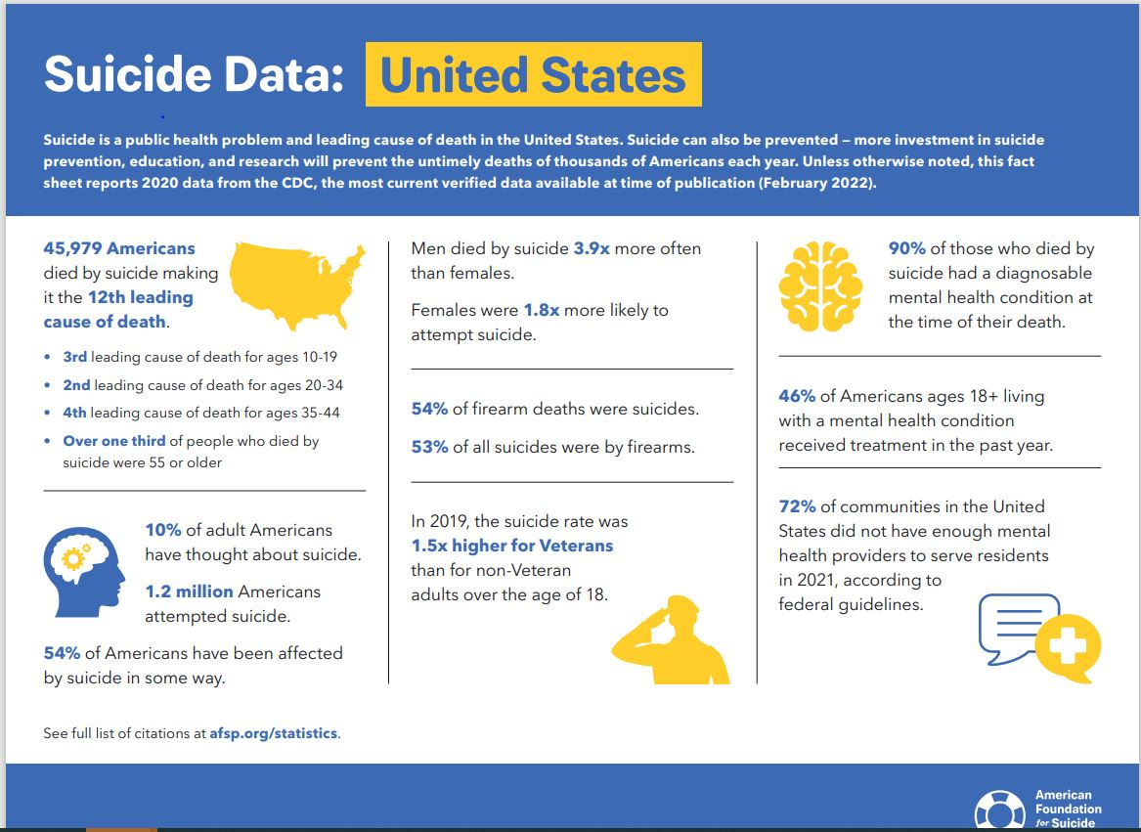

Slide 3


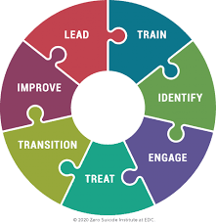



Over 38% of individuals have made a healthcare visit (eg., primary care, emergency department, specialty care, etc) within the week before their suicide attempt and 95% have had a health care visit within the preceding year. (Ahmedani, B.K., et al. 2015)
https://zerosuicide.edc.org/
Notes:
Zero Suicide is a Transformational Framework for Health and Behavioral Health Care Systems
The foundational belief of Zero Suicide is that suicide deaths for individuals under the care of health and behavioral health systems are preventable. For systems dedicated to improving patient safety, Zero Suicide presents an aspirational challenge and practical framework for system-wide transformation toward safer suicide care.
Learn More

Slide 4
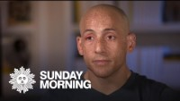
Caring Contacts: Fostering Connection

Slide 5
The Pathway we created for our patients at high risk of suicide
Patients with a suicide attempt are referred to the ZS Pathway from the inpatient treatment team or based on C-SSRS scoring
Enrolled virtually or in person prior to discharge from the inpatient unit
Follow up consists of an initial contact within 24 hours of discharge
Subsequent contacts every day to every other until the patient connects with their outpatient provider/hospital follow up
Continue following patient with caring contacts –via phone and postal –for 30-45 days after inpatient discharge

Slide 6
PATHWAY PROGRAM
­We care about your recovery and want to help you work through this difficult time and find hope. Based on your recent inpatient hospitalization, we feel it is important to offer you extra attention while you transition to your outpatient providers.
We would like to place you in a special program we offer to help people who have thoughts of suicide. We call it a care pathway. The pathway is meant to help keep you safe during the time you leave the hospital until you connect with your outpatient providers.
We will offer you regular times where a counselor or nurse will contact you. It is also a time where we will review the safety plan that you created with your treatment team while you were on the inpatient unit and complete a safety check with you.
We would like to be sure that you have a plan to get rid of the means or method you might use to hurt yourself. Your family members or a friend may need to help with this.
We hope to reach you daily, or a couple of times during the week prior to your outpatient appointment. We will also need information of a contact person in case we cannot reach you.
If you do not keep your initial appointment, we will try to call you. If we cannot reach you immediately, we will continue to call you and your emergency contact. We will continue to reach out to you over the month following your discharge. Once you have started your outpatient treatment and you are feeling better, we will no longer need to reach you regularly, but we will ensure that you have crisis follow up information in case it is needed.
Overall, we want to provide you with the best care possible at this difficult time and help you along your path to recovery. We want you to feel supported and hopeful about tomorrow.
If you are in crisis, call 704-444-2400.

Slide 7
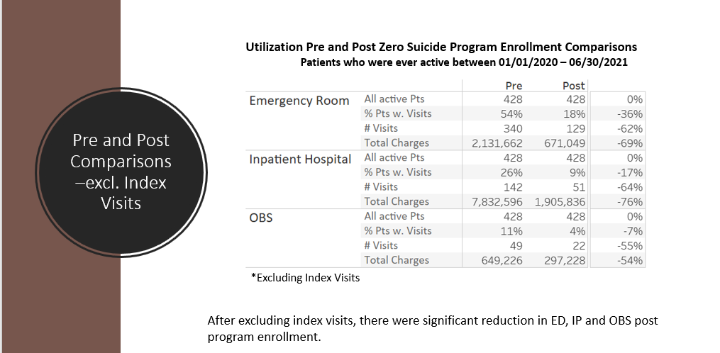
Results of enrollment in our Pathway

Slide 8
Conclusions
Throughout the time period of 1/20 –6/21, emergency room visits dropped by 62% for those patients enrolled in the Zero Suicide Pathway
Emergency Department billing charges dropped by 69%
Reported suicidal ideation in this high-risk population dropped by 98%
Inpatient psychiatric visits dropped 64%
Inpatient psychiatric billing charges dropped by 76%
Overall monetary savings totaled $7,387,373 of unneeded behavioral health care

Slide 9
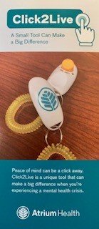
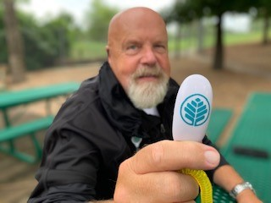
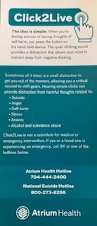
CLICK2LIVE

Slide 10


