Slide 1
Behavioral Healthcare Access and Quality:
Lessons Learned During the Covid-19 Pandemic
Thursday, Nov. 19, 2020: 12:30 p.m. ET

Slide 2
Introductions
Kirsten Beronio, JD – Director of Policy and Regulatory Affairs, National Association for Behavioral Healthcare
Anne Kelly, EdD, BSN – Chief Quality and Compliance Officer, Acadia Healthcare
Frank Ghinassi, PhD, ABPP – President and CEO, Rutgers Health, University Behavioral Health Care and Senior VP, Behavioral Health and Addiction Services Line, RWJ Barnabas Health
Joe Pritchard – CEO, Pinnacle Treatment Centers, Inc.

Slide 3
Overview – Kirsten Beronio
Increased Need for Mental Healthcare and Addiction Treatment
Rapid Response by Behavioral Healthcare Providers:
  Addressing Behavioral Health Needs of Communities
  Infection Control
  Addiction Treatment Challenges
Building on this Experience to Increase Access to Care

Slide 4
Increased Need for Mental Healthcare and Addiction Treatment – Kirsten Beronio
Reports of increased incidence of depression, anxiety, substance abuse, and suicidal ideation
Strain on healthcare professionals
Increased demand for services

Slide 5


Rapid Response by Behavioral Healthcare Providers: Addressing Behavioral Health Needs of Communities
Frank A. Ghinassi, PhD, ABPP
President and CEO, Rutgers Health University Behavioral Health Care and
Senior VP, Behavioral Health and Addictions Service Line, RWJ Barnabas Health

Slide 6
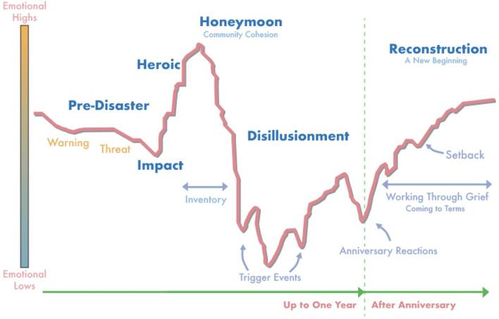
Community Phases of Recovery
6
Adapted from Zunin and Myers, as cited in Morganstein JC and Ursano RJ, Frontiers in Psychiatry, 2020.
Notes:
Phase 1the pre-disaster phase
is characterized by fear and uncertainty
The specific reactions a community experiences depend on the type of disaster
Disasters with no warning can cause feelings of vulnerability and lack of security; fears of future, unpredicted tragedies; and a sense of loss of control or the loss of the ability to protect yourself and your family
On the other hand, disasters with warning can cause guilt or self-blame for failure to heed the warnings
The pre-disaster phase may be as short as hours, or even minutes, such as during a terrorist attack, or it may be as long as several months, such as during a hurricane season.
Phase 2, the impact phase
is characterized by a range of intense emotional reactions
As with the pre-disaster phase, the specific reactions also depend on the type of disaster that is occurring
Slow, low-threat disasters have psychological effects that are different from those of rapid, dangerous disasters
As a result, these reactions can range from shock to overt panic
Initial confusion and disbelief typically are followed by a focus on self-preservation and family protection
The impact phase is usually the shortest of the six phases of disaster.
Phase 3, the heroic phase
is characterized by a high level of activity with a low level of productivity
During this phase, there is a sense of altruism, and many community members exhibit adrenaline-induced rescue behavior
As a result, risk assessment may be impaired
The heroic phase often passes quickly into phase 4.
Phase 4, the honeymoon phase
is characterized by a dramatic shift in emotion
During the honeymoon phase, disaster assistance is readily available
Community bonding occurs
Optimism exists that everything will return to normal quickly
As a result, numerous opportunities are available for providers and organizations to establish and build rapport with affected people and groups, and for them to build relationships with stakeholders
The honeymoon phase typically lasts only a few weeks.
Phase 5, the disillusionment phase
is a stark contrast to the honeymoon phase
During the disillusionment phase, communities and individuals realize the limits of disaster assistance
As optimism turns to discouragement and stress continues to take a toll, negative reactions, such as physical exhaustion or substance use, may begin to surface
The increasing gap between need and assistance leads to feelings of abandonment
Especially as the larger community returns to business as usual, there may be an increased demand for services, as individuals and communities become ready to accept support
The disillusionment phase can last months and even years
It is often extended by one or more trigger events, usually including the anniversary of the disaster.
Phase 6, the reconstruction phase
is characterized by an overall feeling of recovery
Individuals and communities begin to assume responsibility for rebuilding their lives, and people adjust to a new “normal” while continuing to grieve losses
The reconstruction phase often begins around the anniversary of the disaster and may continue for some time beyond that
Following catastrophic events, the reconstruction phase may last for years.

Slide 7
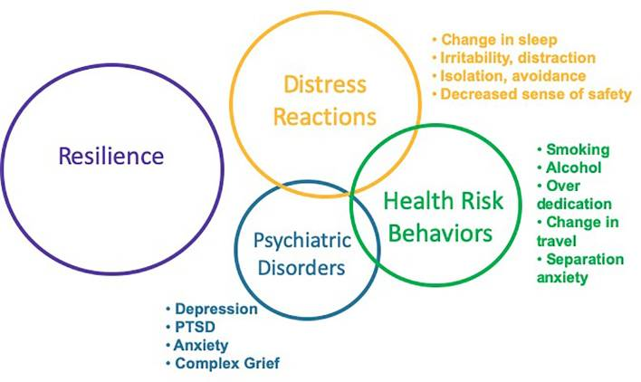
Responses to Disasters
7
Notes:
Considerations of adverse psychological and behavioral effects often focus on psychological disorders, such as Posttraumatic Stress Disorder, Depression, and Anxiety. These disorders do occur following disasters and result in considerable morbidity and mortality, warranting prompt assessment and evidence-based interventions. In addition to disorders, earlier and more common responses include distress reactions and health risk behaviors. In healthcare settings, concerns such as insomnia, anxiety, and altered substance use patterns are most commonly identified in primary care and emergency settings. It is important for healthcare systems to ensure adequate education and resourcing of primary care and emergency personnel to manage the predictable responses following ecological disasters. Understanding the broad range of adverse effects will enhance planning and preparedness, as well as response and recovery efforts, by disaster managers, healthcare personnel, and community members. It is important that education and training for healthcare personnel and disaster managers continue to evolve beyond contemporary approaches of diagnosing and treating illness. Instead, there should be a transition to early screening and delivery of public health interventions that are evidence-based, cost-effective, readily accessible, and community-focused with the goal of reducing distress, enhancing well-being and functioning, reducing the rate of progression to psychological disorders and, ultimately, improving the overall trajectory of community recovery following disasters.

Slide 8
Psychological First Aid

Slide 9
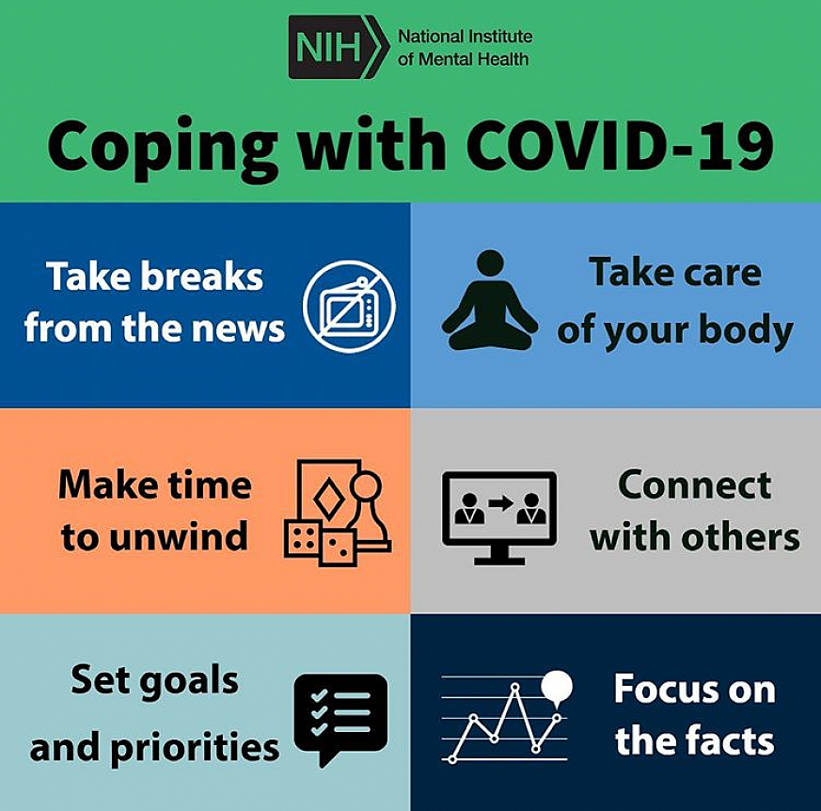

Slide 10
The Five Major Principles
Safety
Calmness
Self-Efficacy
Connectedness
Hope and Optimism
10
Adapted from: Hobfoll, Psychiatry, 2007.

Slide 11
Addressing the Health Needs of the Community

Slide 12
Mental Health Consequences
Anxiety
Depression
Substance use
Loneliness
Domestic violence/child abuse
12
Galea S, JAMA Internal Medicine, 2020.

Slide 13
Mental Health Solutions
Digital technologies
Social media
Routines
Nontraditional groups for psychological first aid
Social distancing v. safe places
13
Galea S, JAMA Internal Medicine, 2020.

Slide 14
Quarantine Stressors
Longer quarantine duration
Inadequate information
Inadequate supplies
Fear, frustration, and boredom
Financial loss
Stigma
14
Brooks SK, The Lancet, 2020.

Slide 15
Quarantine Solutions
Keep it as short as possible.
Give as much information as possible.
Provide adequate supplies.
Reduce the boredom.
Altruism is better than compulsion.
15
Brooks SK, The Lancet, 2020.

Slide 16

Health Care Professionals
Hear me
Protect me
Prepare me
Support me
Care for me
16
Shanafelt T, JAMA, 2020.

Slide 17

UBHC
Move to Telehealth
  Doxy.me
  Zoom
  WebEx
  Telephone
  Individual and Groups

Slide 18

NJ DOC & UCHC
PPE
Entry Screening
Active Treatment
Isolation & Quarantine
Contact Tracing
Testing

Slide 19

School Based Programming

Slide 20
Workforce Resiliency
EAP
National Call Center lines
Rutgers4U (1-855-652-6819)
COVID Coordinating Entity (SAMHSA)

Slide 23

Rapid Response by Behavioral Healthcare Providers: Infection Prevention and Control
Anne Kelly, EdD, BSN
Chief Quality and Compliance Officer, Acadia Healthcare

Slide 24

Infection Prevention and Control
Isolation units, constant-wear PPE, and social distancing:
Who could have predicted that at the beginning of 2020?
First things first:
  Enhanced Infection Prevention and Control Plans
  CDC-based, ongoing practices
  Staff and leadership support
  Engagement of experts

Slide 25
The Importance of Screening and Testing
Situational awareness and high reliability principles in action
Screening
  Patients – prior to admission, upon admission, throughout stay
  Staff – prior to start of shift
  Visitors and others – prior to entry into the facility
Testing
  Laboratory versus Rapid Testing
  Special considerations
  Challenges with supplies and access

Slide 26


Finding and Maintaining PPE and Supplies
COVID-19 and the Impact on PPE and Supplies
Solving the early days of national shortages
Personal Protective Equipment (PPE)
  Changes and increased use
  Caring for behavioral health patients in PPE
Masks and behavioral health patients

Slide 27
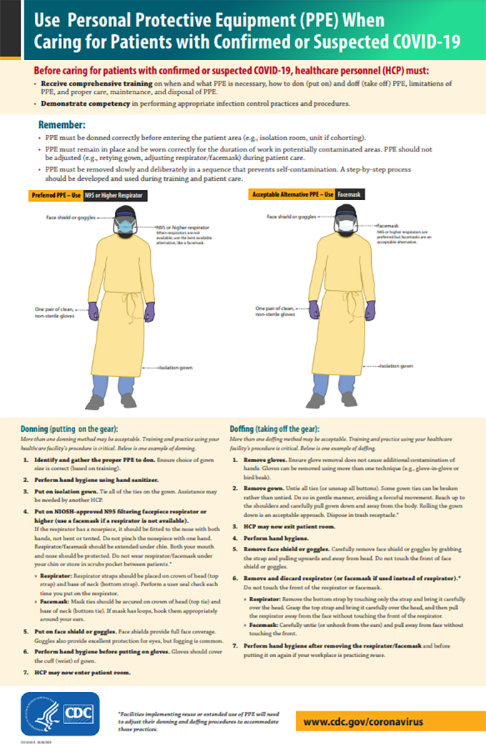
Special Considerations
Managing COVID-19 on behavioral health units
  Quarantine/precautionary units
  Managing isolation units
  Use of PPE
  Donning and doffing stations
Discharge to medical facilities
  Identifying medical issues
  Transfers and admissions

Slide 28
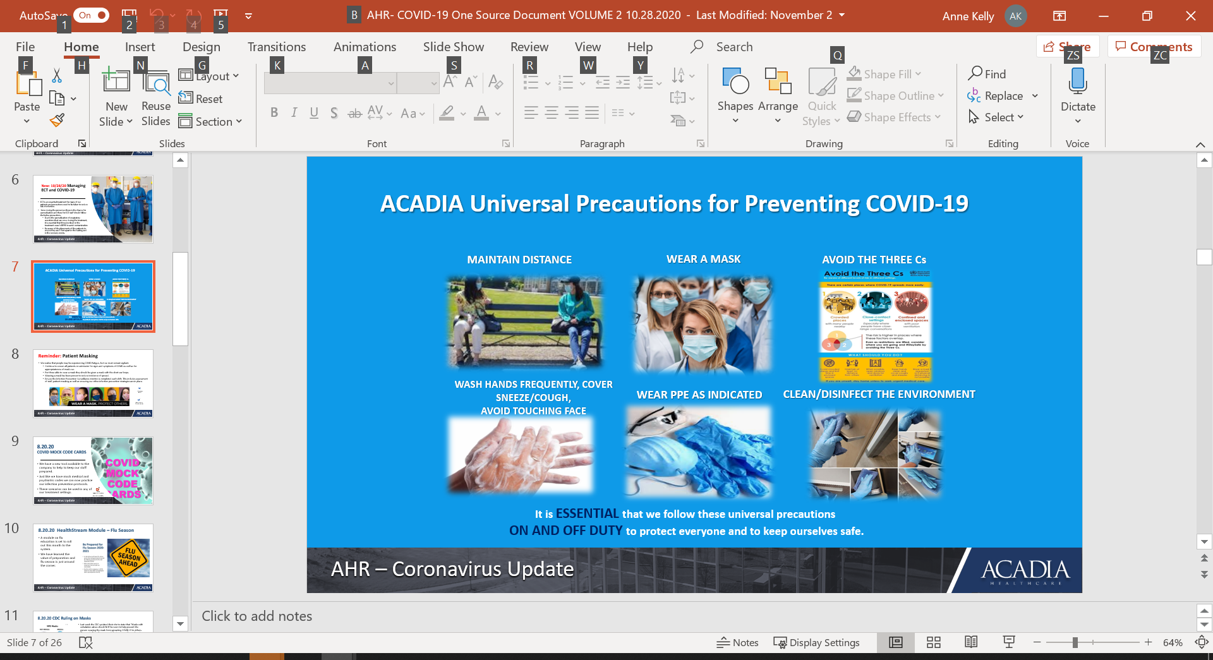
Universal Precautions
Considering others – patients, staff, and visitors – as positive.
Mask + Distance
Universal precautions reduces risks associated with human factors.

Slide 29

Rapid Response by Behavioral Healthcare Providers: Addiction Treatment Challenges
Joe Pritchard
CEO, Pinnacle Treatment Centers, Inc.

Slide 30
Addiction Treatment Challenges – Joe Pritchard
Use of Telehealth - Critical for patients and clinicians
  Many clinicians at risk due to older age
  Increased costs for providers
  Importance of covering audio-only services
  Challenges with provider and patient fatigue
Expanded authorization of take-home methadone medication
  Induction into methadone not permitted via telehealth
Infection control in residential treatment settings
Use of technology to improve connectivity with emergency rooms and jails/prisons to increase access to treatment

Slide 31
Building on Covid-19 Experience to Increase Access to Care – Kirsten Beronio
Continue expanded coverage of telehealth including audio-only services
Maintain telehealth reimbursement rates comparable to in-person treatment
Continue allowing take-home methadone medication
Continue to allow buprenorphine prescribing via telehealth for new and existing patients
Maintain regulatory flexibility for practitioners to practice to full extent of license
Increase behavioral healthcare supports for healthcare professionals
Simplify reporting requirements for Covid-19 funding and data collection

Slide 32
Additional Changes to Improve Access to Care – Kirsten Beronio
Waive IMD Exclusion in Covid-19 hotspot areas to free up inpatient beds
Increase support for education services in residential treatment settings
Provide federal funding for 988 universal mental health crisis hotline implementation in every state
Improve mental health and addiction parity law by requiring utilization management be based on independent clinical standards
Allow methadone induction via telehealth

Slide 33
Questions?

